Slide 1
Mahindra First Choice Services
Driving business through data

Slide 2
Business Problem
MFCS would like to expand their reach by increasing the customer service points. (Assumption – this could also be done in order to increase the market share by replacing competition)
They are targeting to open 60+ new workshops in a span of 15 months
Notes:
A business usually have either of these objectives –
Expansion – New workshops
Continuity – How to keep the good business consistent, maintaining the current demand supply consistent.
Profitability – By revising pricing strategy (altering price based on demand) OR reducing costs by identifying factors related to cost
Weaken competition – By opening centres closest to competition OR better service plans & packages, freebies, discounts, festive offers etc

Slide 3
Why solve this problem?
There could be multiple reasons to do this activity:
  Understand ways to increase profitability (by knowing cost factors 7 their impact)
  Maintain continuity of good business (understanding positive reinforcements)
  Beat competition (understanding reach, geographical presence & identifying opportunity to open new centers.
Stakeholders Impacted
Stakeholders could be:
  Marketing Head (understand the ROI & success metrics of various activities)
  Sales head (understand demand supply function based on various factors)
  Operations head (understand ways to achieve efficient processes & provide better customer service)

Slide 4
Exploratory Data Analysis

Slide 5
Car Ownership and Spending Patterns

Slide 6
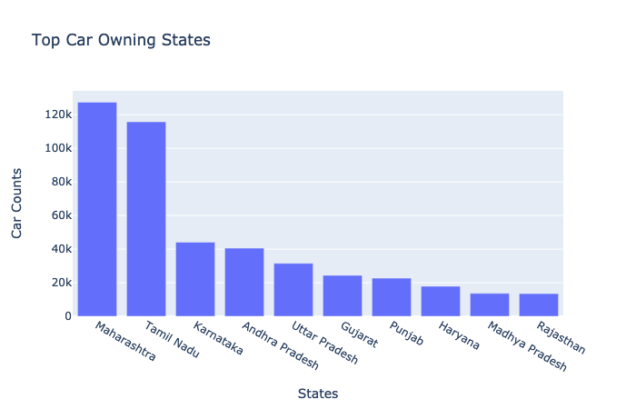
Top States
Notes:
-Which areas have most cars?

Slide 7
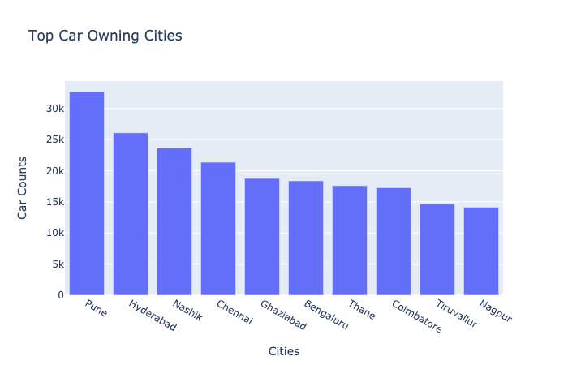
Top Cities
Notes:
-Which areas have most cars?

Slide 8
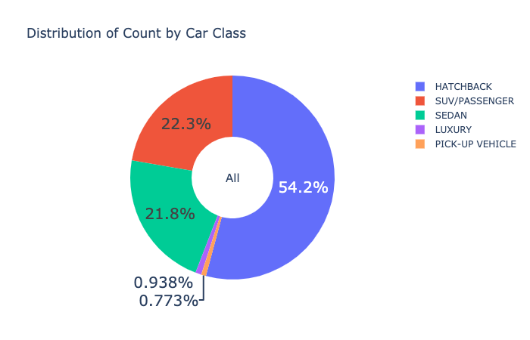
Top Car Classes (Pan India)

Slide 9
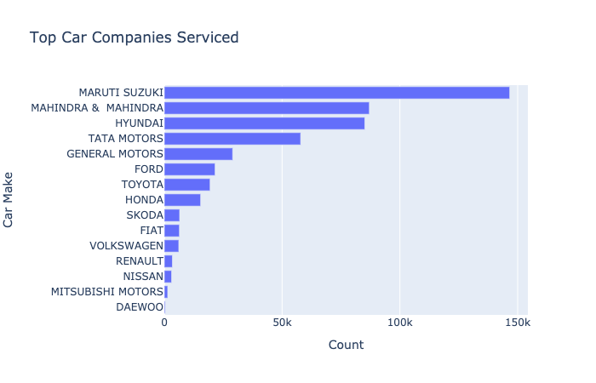
Top Car Companies (Pan India)
Notes:
- Which Car / Make is more popular?

Slide 10
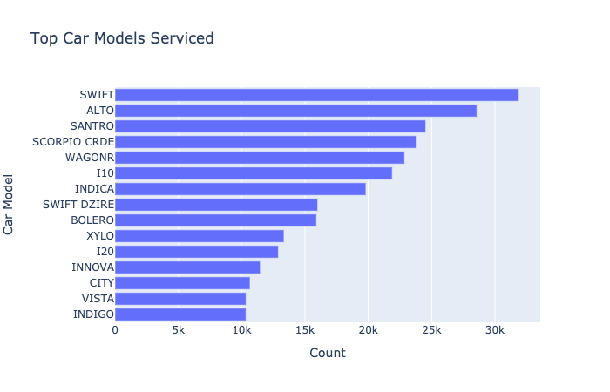
Top Models (Pan India)
Go to Dashboard
Notes:
- Which Car / Make is more popular?

Slide 11
Insights
Looking at the Hatchback count and revenue distribution, it gives a definite idea of the lower servicing cost of this segment of cars.
SUV/Passenger tend to generate more revenue, as compared to their share by number of cars.
  SUV’s are bought to be used on rugged terrain, thereby leading to more wear and tear and hence frequent servicing
  SUV/Passenger are run for longer km’s due to their use in tour and travel industry
Mahindra & Mahindra being the second in the number of cars tops the revenue charts. Reasons:
  The point above can be validated, SUV have high service need and generate more revenue
  Mahindra owners would have a high footfall at company owned service centres

Slide 12
Insights
Maruti Suzuki has less accident counts but are expensive on Accidental repairs this could be attributed to reasons like less sturdy structure and inferior quality.
While Mahindra has high redemption on SMC packages, but least contribution in revenue, this could infer it needs to work on the pricing strategy of these packages
Pune has more cars, reasons could be lack of good public conveyance, low cost of living, availability of service class population and therefore high affordability to buy cars, could infer it needs to work on the pricing strategy of these packages

Slide 13
Service Types

Slide 14
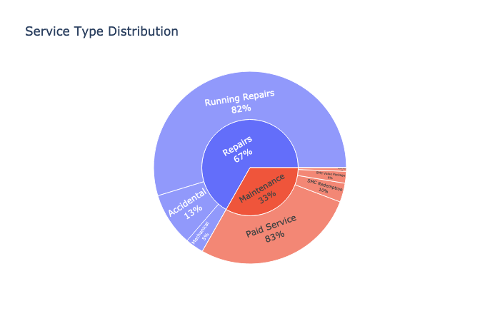
Service Structure Distribution (All Cars – Pan India)
Go to Dashboard
Notes:
- -What is service structure for particular make/car?

Slide 15
Insights
Maximum number of cars are serviced in the km range of 50K-100K.
While there are no spikes seen in revenue all through a car’s lifetime, accidental damages top the chart in terms of revenue and become exponential after a car crosses 1.6M kms, which may infer a car beyond 1.6M kms, becomes more prone to accidents
While labor costs of MFCS remains constant in almost all service types, the outsourced labor is the highest in case of accidental repairs.
While paid services top the chart in terms of demand, accidental services contribute maximum portion of the revenue generation. Accidents being uncontrollable activity, is not something that can be worked upon to enhance revenue hence one must look at the second best category i.e. running repairs.
Common spikes seen across region in the month of May(onset of vacations), July(onset of Monsoons) and October(festival seasons/offers).

Slide 16
Marketing Sources

Slide 17
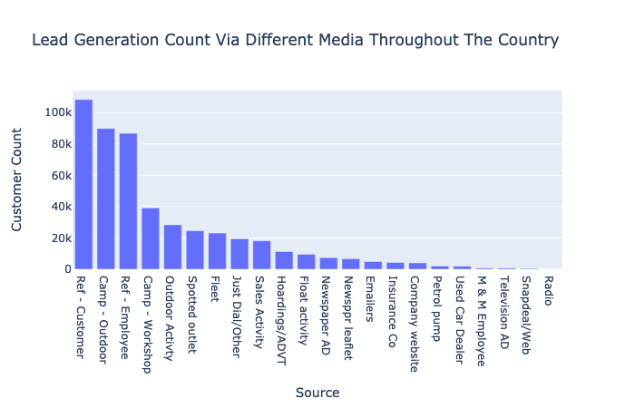
Marketing Sources (Pan India)

Slide 18
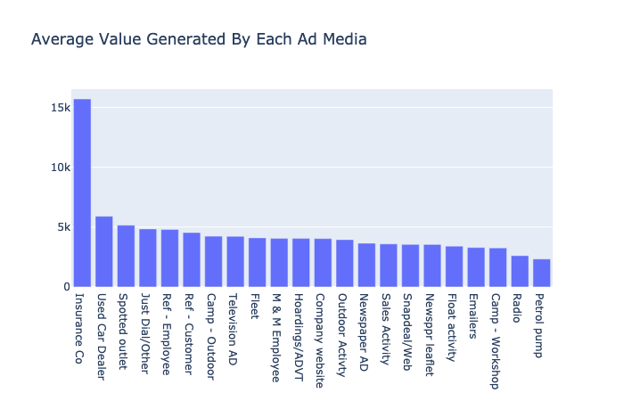
Marketing Sources Revenue (Pan India)

Slide 19
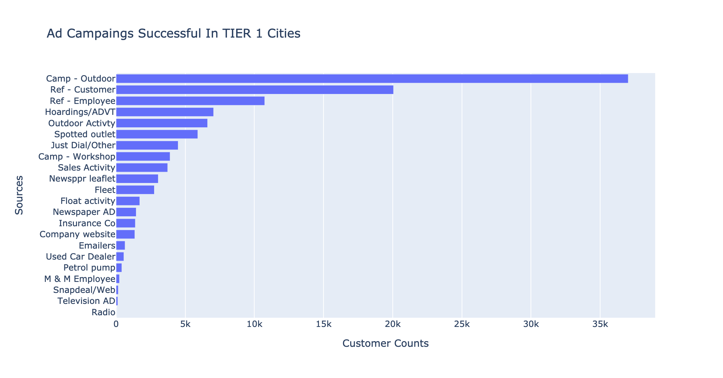
Marketing Sources
(Tier 1 Cities)

Slide 20
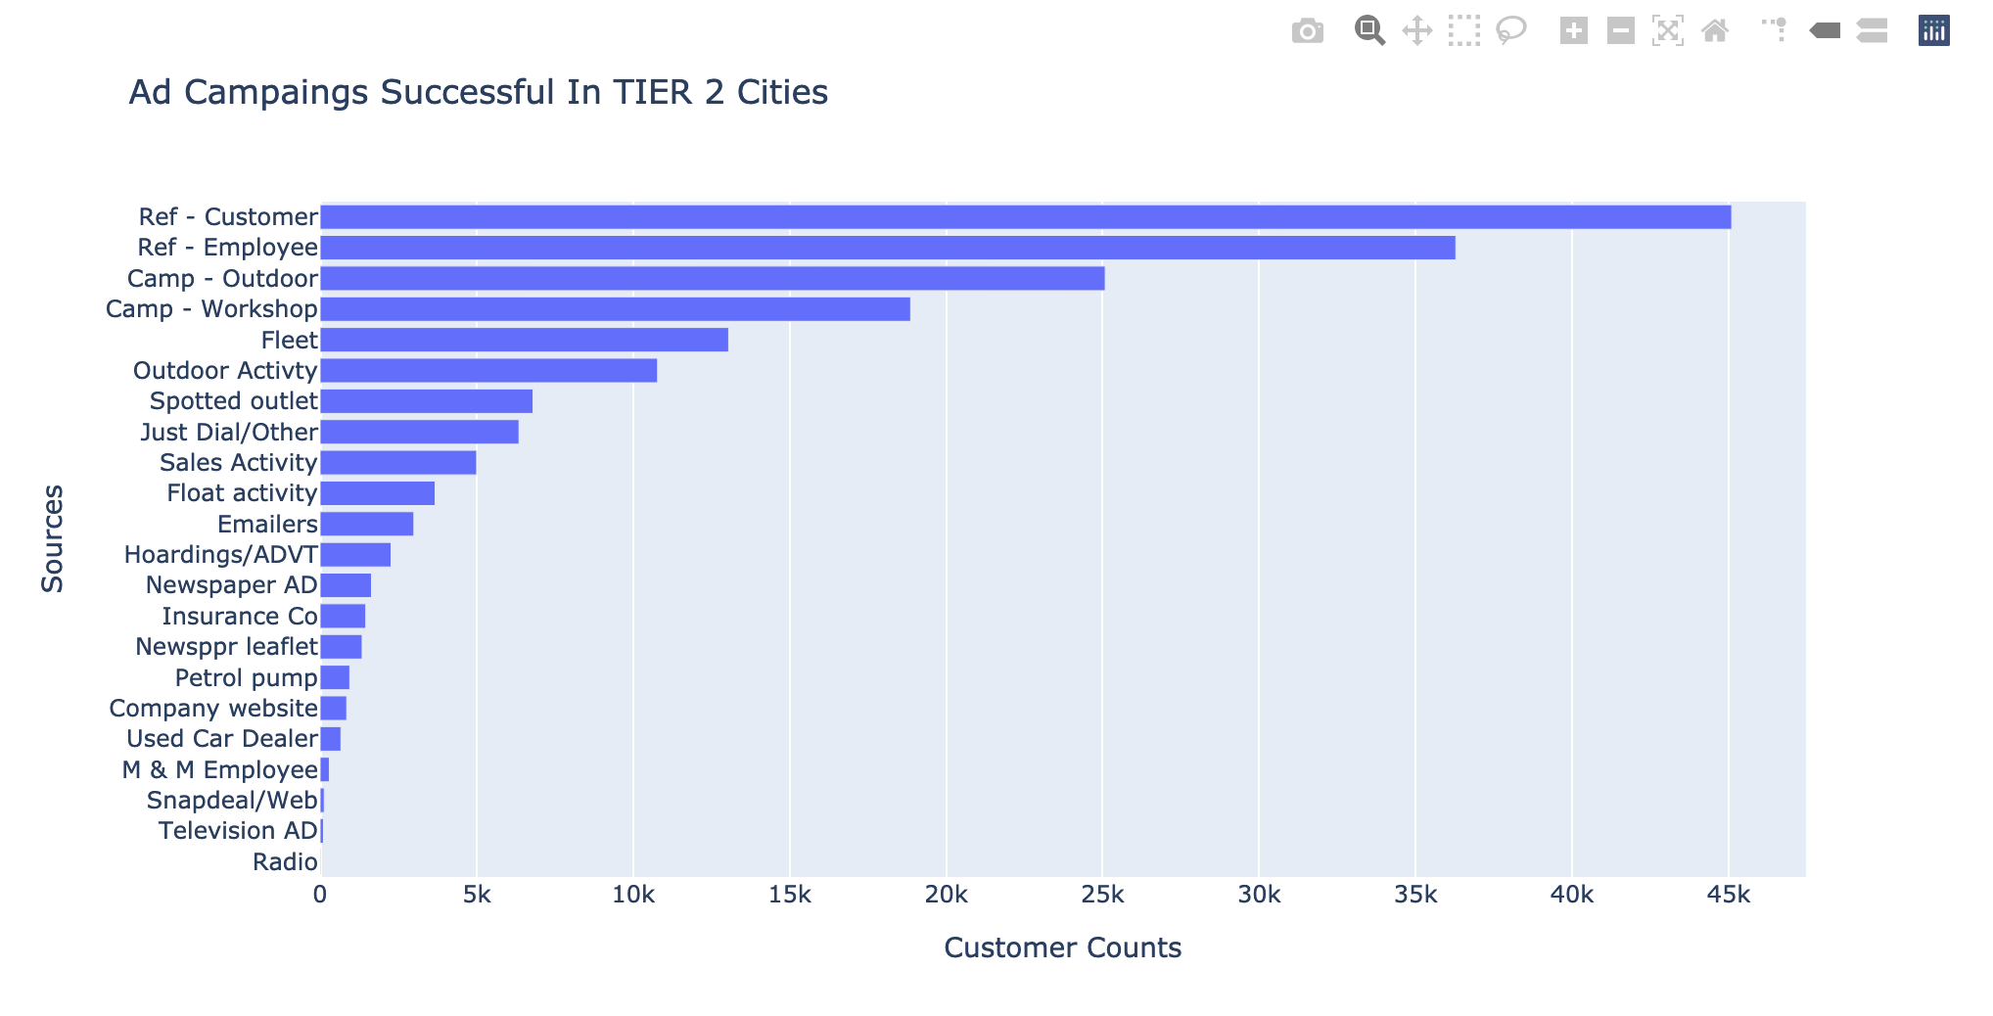
Marketing Sources
(Tier 2 Cities)

Slide 21
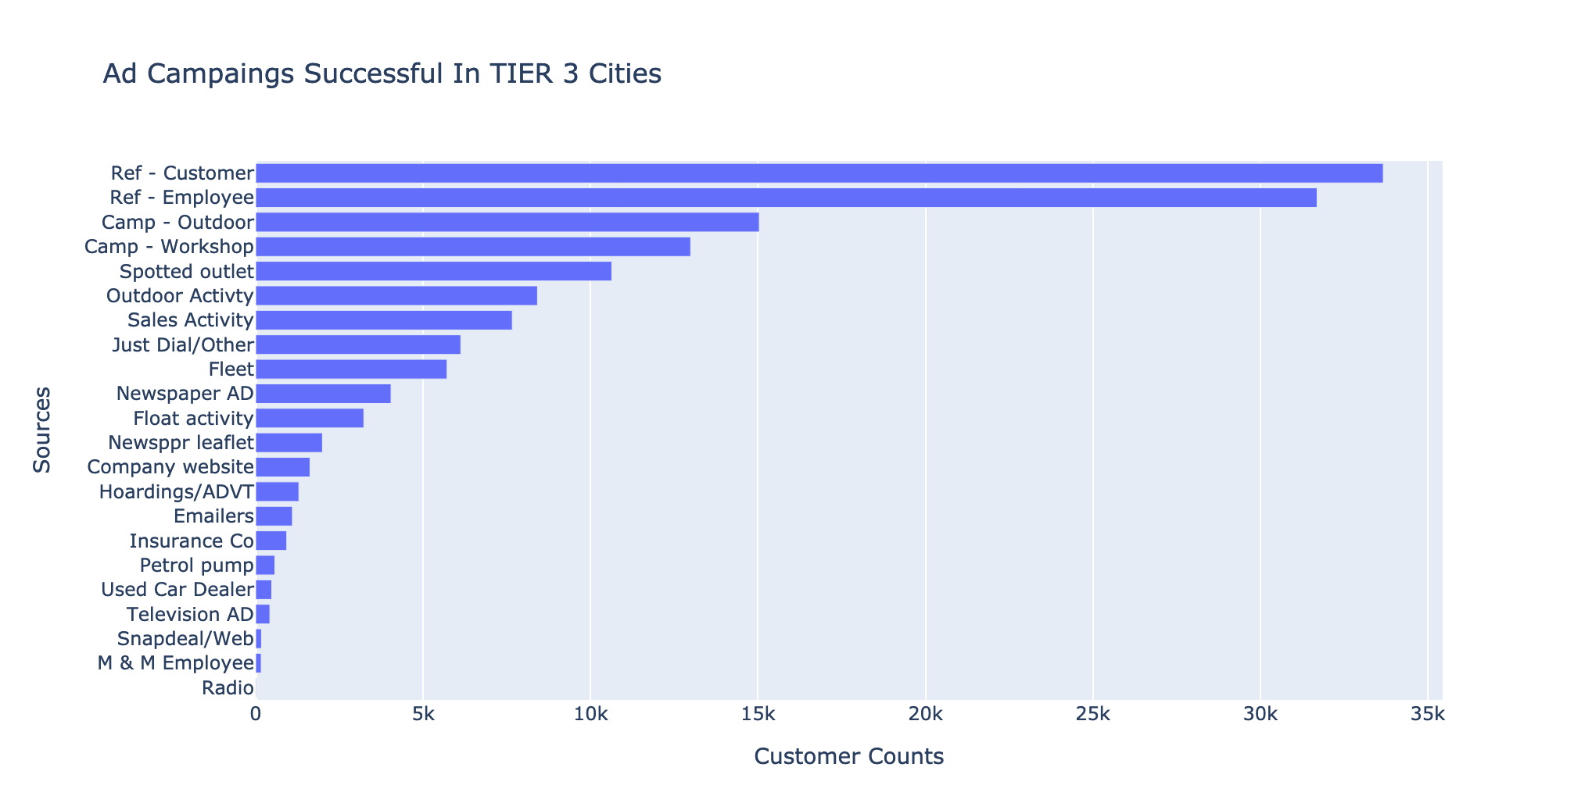
Marketing Sources
(Tier 3 Cities)

Slide 22
Insights
Top 3 lead generating channels include references, campaigns and outdoor activities i.e. cost intensive marketing activities like hoardings, TVC or any other media promotion are not fruitful.
Insurance is the best alternate source of revenue and can be focused for targeted marketing.
Of all the leads generated, almost 50% leads for categories like luxury, hatchback, sedan & SUV were generated either via word of mouth (references – customers / employees) or outdoor activity.

Slide 23
Workshops

Slide 24
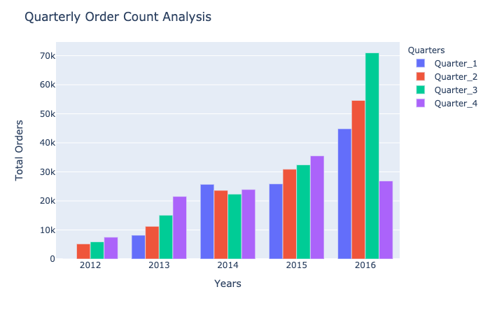
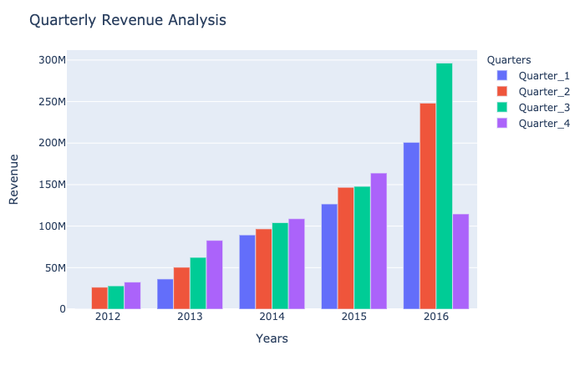
Quarterly Growth (Pan India)
*calendar year quarters
Go to Dashboard

Slide 25
Insights
There has been consistent upward movement in terms of number of cars serviced, revenue generated as well as the number of workshops opened.
Year 2014 saw a dip in the count of cars serviced, reason could be – strategic change by Mahindra group, this was also visible in the workshop distribution graph & map as there were not many new workshops added in the year 2014 compared to high additions seen in other years.

Slide 26
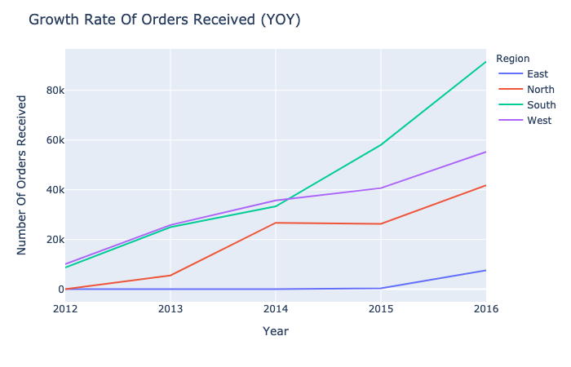
Growth Trends
Zone Wise Orders

Slide 27
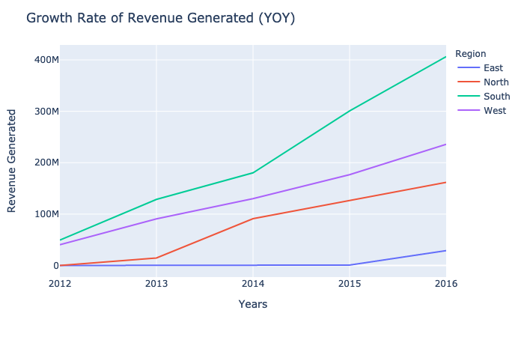
Growth Trends
Zone Wise Revenue

Slide 28
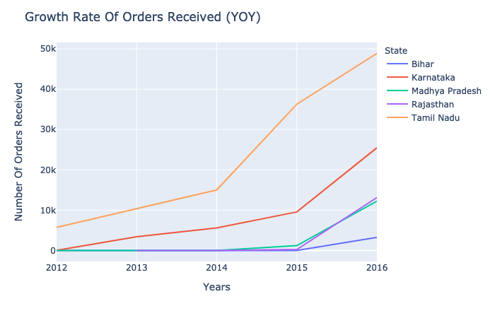
Top Growing States (Orders)

Slide 29
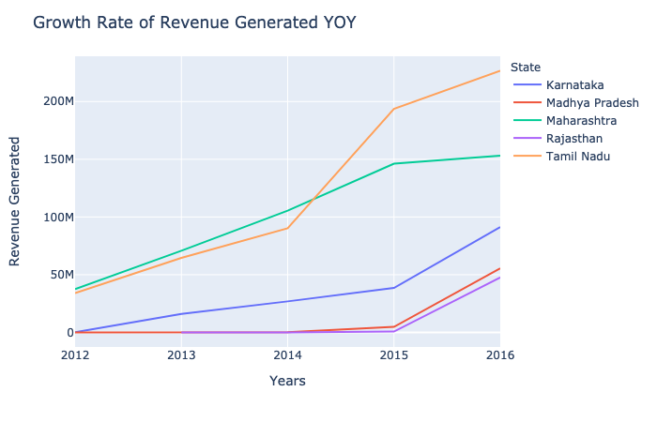
Top Growing States (Revenue)

Slide 30
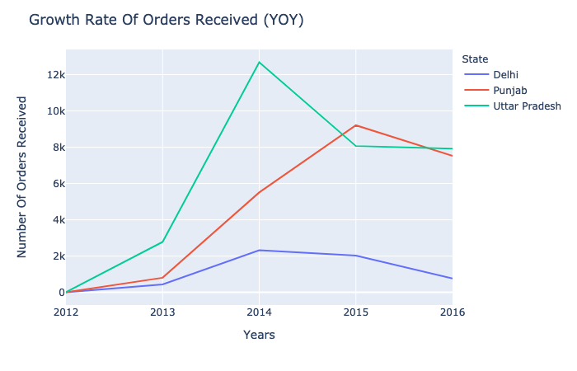
Bottom Declining States (Orders)

Slide 31
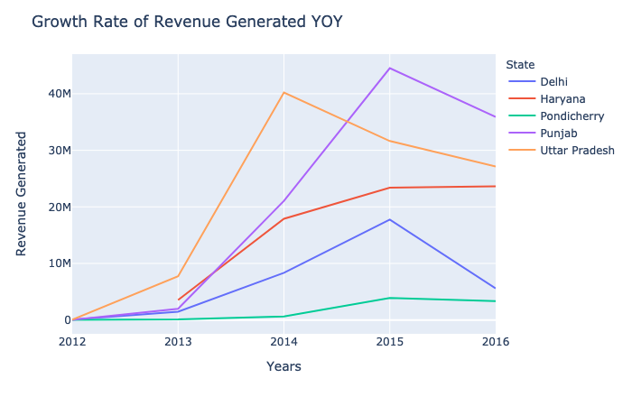
Bottom Declining States (Revenue)

Slide 32
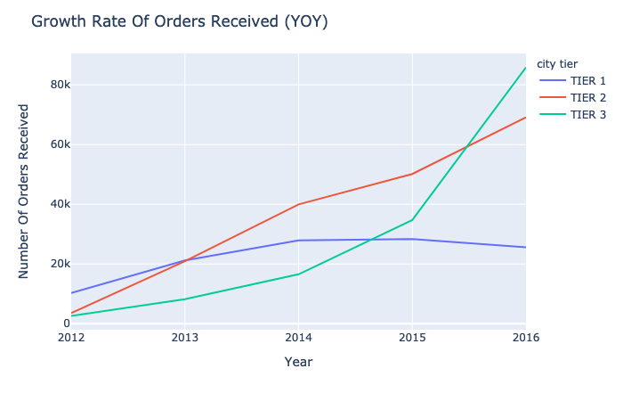
Growth Trends (City Tiers)

Slide 33
Insights
Zone as well as State level
  East needs penetration and attention in terms of presence of workshops (Bihar is amongst top 5 states)
  South has been improving at a steep curve
  North has shown improvements in alternate years after constant growth
  West has been slow and consistent as compared to other zones but can catch up with south if focused. (both in terms of numbers & revenue).
Bottom States – While North seems to be doing fairly consistently as a zone, states like Punjab, Haryana, Delhi & UP need attention to identify reasons for decline. Similarly for Pondicherry in South zone.
Tier level – Tier 1 cities need attention as there is decline seen (might be entry of new competition / activity by an old player)
Tier 3 can be focused upon to achieve consistent growth, this could be through specialized schemes & programmes.

Slide 34
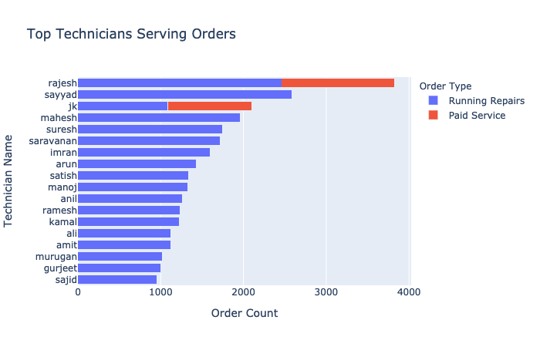
MFCS Experts

Slide 35
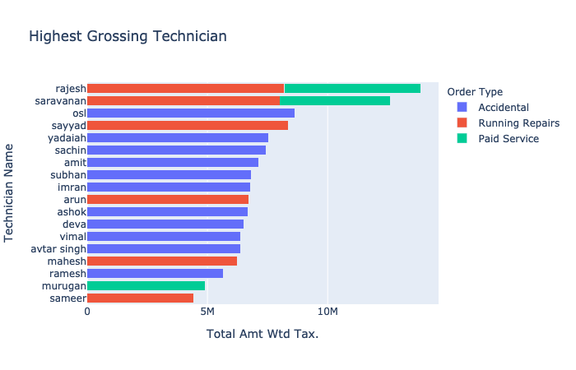
MFCS Experts

Slide 36
Customer Segmentation

Slide 37
Why RFM?
What is RFM?
RFM analysis allows you to segment customers by the frequency and value of purchases and identify those customers who spend the most money.
  Recency – how long it’s been since a customer bought something from you
  Frequency – how often a customer buys from you
  Monetary value – the total value of purchases a customer has made
RFM is an excellent segmentation method for predicting customer responses, improving interactions, and increasing profits. RFM uses customer behaviour data to determine how to work with each customer group.

Slide 38
Approach
Calculate RFM Values
Scaling to feed into Model
Elbow Method to find Optimal Clusters
K-Means Clustering (K=4)
Combined Frequency and Monetary Value
Rule Based Segmentation

Slide 39
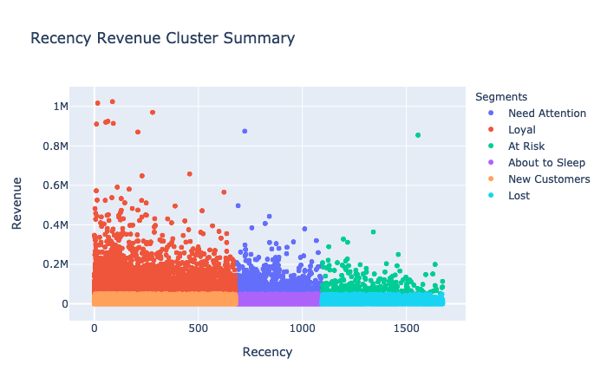
Customer Analysis

Slide 40
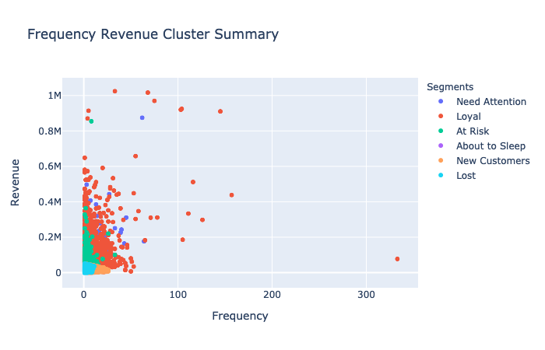
Customer Analysis

Slide 41
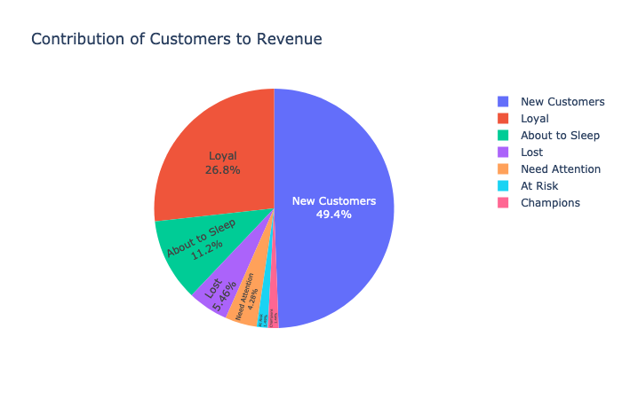
Revenue Distribution

Slide 42
Insights
Loyal customers have been seen to spend equal proportions on all types of services while the rest of the others visit mainly for running repairs & paid services.
There should be customized marketing programmes that can be designed to target each customer segment – New, Loyal, Need attention, About to sleep, lost etc

Slide 43
Customer Lifetime Value Prediction

Slide 44
What is Lifetime Value?
Lifetime value of a customer is the total amount that the customer is expected to spend on our business, during their lifetime.
Based on the historic data, we identify the value associated with each customer, and then predict the value of a set of customers in the same segment.
How do we predict it?
We begin by identifying the average order value that the customer brings per visit, and their total visits.
We also consider the profit margin and the repeat rate of customers
We then calculate the CLV (Customer Lifetime Value) and segment customers on that basis
In the end we have a model that predicts the value for our existing customers in the coming period, or for segmenting a new set of customers.

Slide 45
Methodology
To arrive the average order value of our customers, we are taking the Car Make Model into consideration, as this is our best metric to identify the lifetime of a customer with us.
We later map the average value of car to the customer based on his ownership.
We will be using 2 methods to derive our CLV, and then take the aggregate mean of both, for a better calculation.
1. Simple Formula: Average Order Value X Average Lifetime Span (on an average how many days the customer stayed with us)
2. Custom Formula :
Average Order Value X Average Lifetime Span*Profit Margin ratio)/Churn Rate

Slide 46
Pipeline
Feature Selection and Engineering
Defining Variables and Constants
Segmenting Customers on Quantiles
Creating categories for Classification
Encoding and Scaling Data for Modelling
Calculating Lifetime Value using Formula
Checking and Removing Multicollinearity

Slide 47
Modelling
Predicting Lifetime Values

Slide 48
Classification & Regression Models
Classification Models
Models | Accuracy
DecisionTreeClassifier | 0.971
RandomForestClassifier | 0.968
XGBClassifier | 0.972
Regression Models
Models | RMSLE
LinearRegression | 1.58
LGBMRegressor | 1.108
LinearRegression (removing Multicollinearity) | 0.48
LGBMRegressor (removing Multicollinearity) | 0.88

Slide 49
Time Series Analysis and Forecasting

Slide 50
What is Time Series Analysis?
Why?
Time series ➔ set of observations of quantitative variable collected over time.
Mathematically, Y = f(T)
Time Series Analysis ➔ Statistical technique to explain past behavior and forecasting future using historical time series data.
Forecasting future sales and the opportunity to serve more customers and serve them better.

Slide 51
Pipeline
Feature Selection
Null Value Imputation & pre-processing
Feature Engineering
Model and Model Tuning
Forecasting

Slide 52
Feature Selection
From “Final_invoice”, using InvoiceDateTime and Total_value, then resampling it on mean daily basis, we got the data as below
 | Invoice_DateTime | Revenue
0 | 2012-04-02 | 2525.442000
1 | 2012-04-03 | 3455.840652
2 | 2012-04-04 | 2958.108205
3 | 2012-04-05 | 4157.551163
4 | 2012-04-06 | 5010.062245

Slide 53
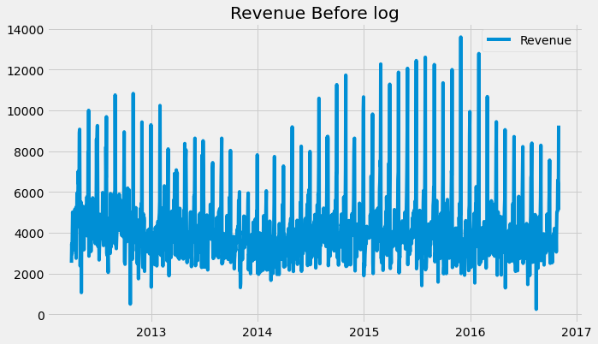
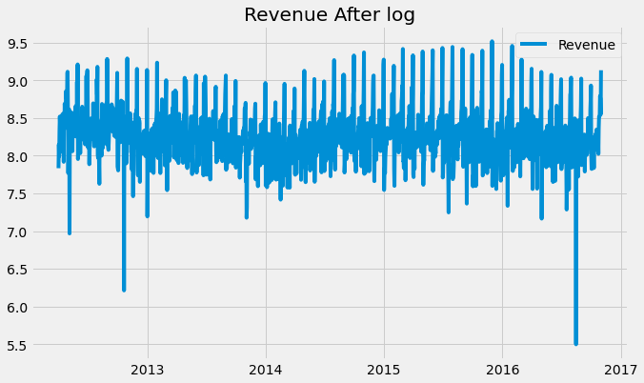
Data Imputation and Preprocessing
Imputation by interpolation for missing dates.
Scaling by log of revenue [for forecasting].

Slide 54
Time Series Data Analysis

Slide 55
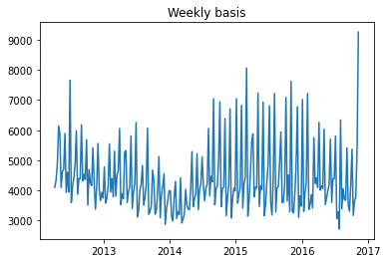
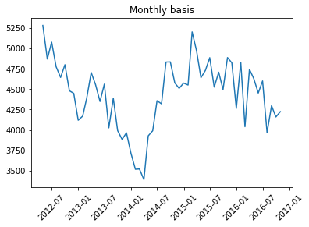
Around March 2014, revenue has recorded lowest value.

Slide 56
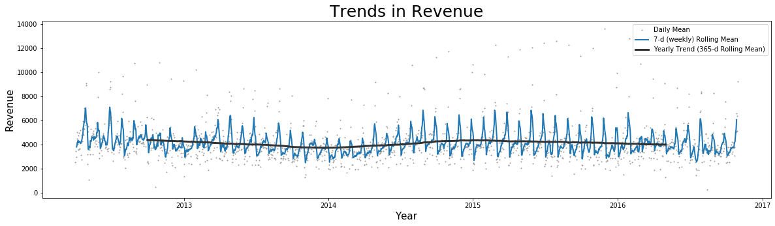
By using rolling windows of 7-days and 365-days, it is clear annual trend is almost stable (almost stationary), revenue has monthly seasonality and a cyclicity of about one year

Slide 57
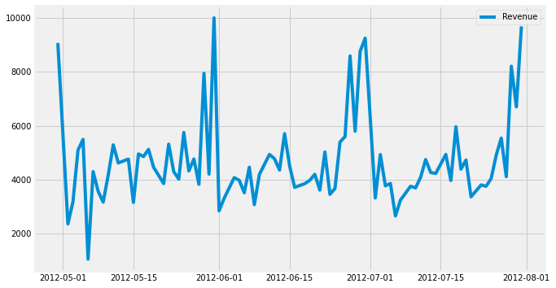
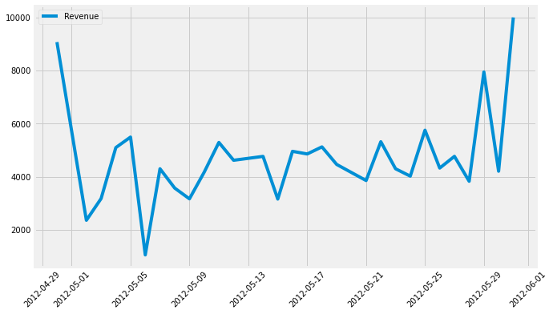
18 Quarterly and 54 Monthly graphs ➔ monthly seasonality ➔high revenue at the end of each month and some irregularities.

Slide 58
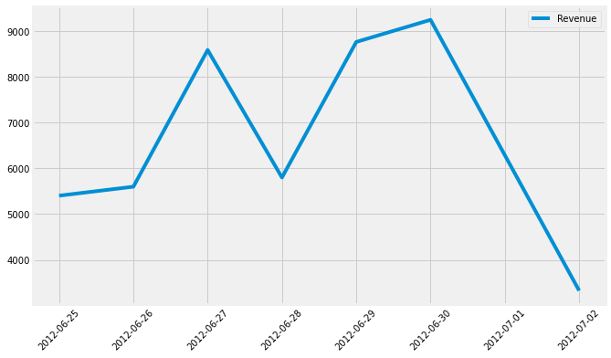
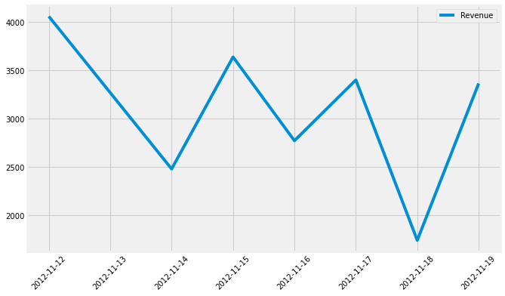
Data Analysis
239 weekly graphs ➔ high revenue ➔ mostly on THURSDAYs, FRIDAYs and SATURDAYs.
Weekly Graph from MONDAY
2012-06-25 to 2012-07-02
Weekly Graph from MONDAY
2012-11-12 to 2012-11-19

Slide 59
Splitting of Data
Taken data from 02-04-2012 to 31-12-2015 for training the model, data from 01-01-2016 to 31-10-2016 for testing and future dates from 01-11-2016 to 31-10-2017 for forecasting.
Feature Engineering
1 new column ➔ 1st order differentiating (De-trending)
Two new columns ➔ ‘Yesterday’ and ‘Yesterday_diff’

Slide 60
Cross Validation
CV with different models and TimeSeriesSplit of 4 splits
Out of these KNN and RF were best, so did GridSearchCV with them.
Model without Grid Search | Mean R2 Score
LR- Linear regression | 0.143
KNN – K Nearest N. | 0.244
RF – Random forest | 0.185

Slide 61
Grid Search CV
Best parameters using Grid Search
KNN Regressor: leaf_size=30,metric=‘minkowski’,neighbour = 10, p=2
Random Forest Regressor: max-depth =7,min_sample_leaf=1,split=2,n_estimator = 100
Results with KNN
Explained variance | 0.217
MAE | 974.9
MSE | 2179534
RMSE | 1476.32
RMSLE | 1.37
Results with RF
Explained variance | 0.255
MAE | 926.87
MSE | 2070031.9
RMSE | 1438.76
RMSLE | 1.42

Slide 62
Forecasting
For forecasting, FB’s Prophet was used as it is more robust to trend and seasonality
The Prophet model was fitted on scaled revenue
Results with Prophet
Explained variance | 0.406
MAE | 868.9
MSE | 2014117.24
RMSE | 1440.18
RMSLE | 0.335

Slide 63
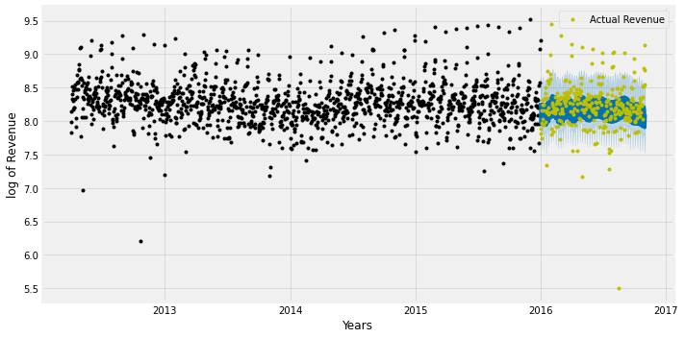
Data Analysis of Forecast
Black ➔ training points
Blue ➔ predicted points
Green ➔ actual points

Slide 64
Data Analysis of Forecast
The stats for next year forecasting are:
More than 2 Quarters ➔ the revenue above 3489 ± 341 INR daily
less than 1 Quarter ➔ min. 2525 INR daily
Forecasting
 | Daily Revenue
mean | 3489.316577
std | 341.404356
min | 2525.657611
25% | 3372.939534
50% | 3562.610708
75% | 3719.732524
max | 4019.903409

Slide 65
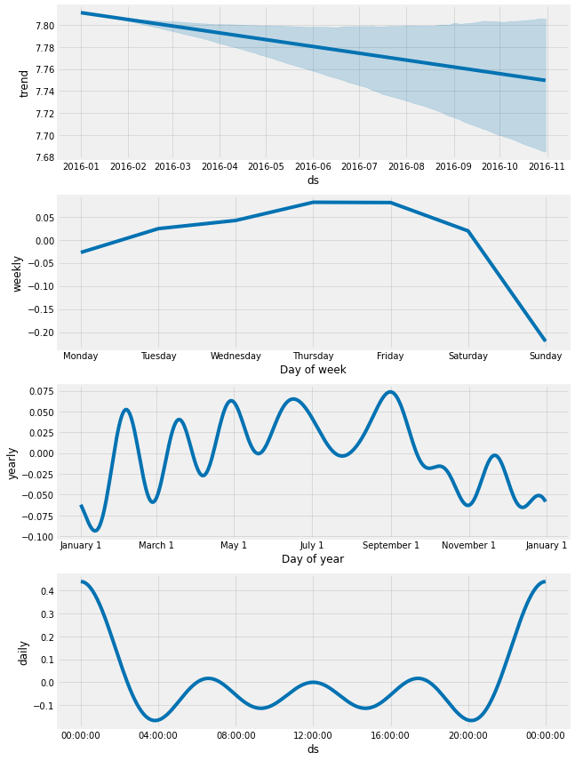
Data Analysis of Forecast
Trend is going down in upcoming year with weekly seasonality and low revenue in :
1] end of Jan 2017
2] start of April 2017
3] end of July 2017

Slide 66
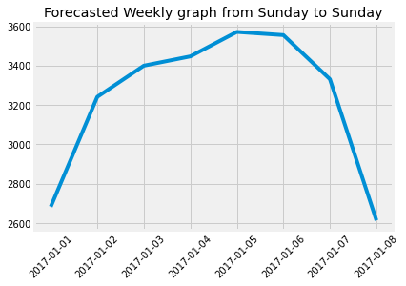
Data Analysis of Forecast
Weekly seasonality is such that every SUNDAYs has low revenue and , almost all THURSDAYs and FRIDAYs have high revenue.

Slide 67
Data Analysis of Forecast
Date | Monthly Sum of Revenue
2016-11-30 | 105630.742338
2016-12-31 | 105754.283343
2017-01-31 | 103765.331606
2017-02-28 | 99359.356801
2017-03-31 | 110547.328654
2017-04-30 | 105694.586370
2017-05-31 | 110178.373563
2017-06-30 | 110052.125873
2017-07-31 | 106862.975900
2017-08-31 | 110440.943676
2017-09-30 | 104830.643116
2017-10-31 | 100483.859211
Some forecasted Revenue
Date | Weekly Sum of Revenue
2016-11-06 | 20566.294512
2016-11-13 | 24386.425327
2016-11-20 | 25007.890259
2016-11-27 | 25030.498731
2016-12-04 | 24386.757560
2016-12-11 | 23712.801168
2016-12-18 | 23550.651433
2016-12-25 | 23743.702015
2017-01-01 | 23682.945084
2017-01-08 | 23157.462178
2017-01-15 | 22762.233103
2017-01-22 | 23250.709750

Slide 68
Insights
Marketing campaign must be run weekly between Thursday to Saturday to attract more customers.
Special offers or complimentary services must be provided for Jan, April and July 2017 to retain the customers as revenue churn is more for that time.
Some market campaign must be done in end of each month to increase the chances of new customers.

Slide 69
Key Take Away & Action Points
Strategical
MFCS sees high traffic as well as revenue from Maruti cars. While Maruti is a competition to Mahindra, either a mutual agreement on profit share or specialized stand alone service schemes for Maruti brand could help in creating a long lasting model
Strategic partnerships or collaboration with other car brands can lead to better servicing of customers, high customer satisfaction, less waiting time, cheaper procurement of inventory and reduction in abruptly high outsourced labour cost (in case of accidental damage)
Maruti should also never be underestimated as major revenue provider also creates high dependency of business. In order to avoid this scenario, MFCS could also target penetration in other car brands like Toyota & Tata.

Slide 70
Geographical
- Zone
- State
- City
Zone - Bihar market could be used as a case study to try and replicate the same strategy in order to uplift East zone as a market starting with cities like Kolkata, Guwahati, etc. (penetration of tourism in the region is a good reason to enter the market)
State - Study the reasons for decline in states like Delhi, Haryana, Punjab, UP in good performing north zone & Pondicherry in top performing south zone via market survey, customer interviews, mystery shopping, on ground activation campaign & specialised schemes & offers to retain customers (About to sleep, lost, need attention customers). Similar strategy could work to understand decline in tier 1 cities.
  Activation camps in regional & local languages
  Referral programme along with incentive in the form of 1 free service
  Local promotion by tie ups with dealers

Slide 71
Geographical
- Zone
- State
- City
City - Tier 2 & 3 are new markets – early adopters must be rewarded for loyalty (repeat visits) & referrals (word of mouth)
City level customer clusters (Pune, Hyd) must be rewarded with customized programmes like –
  Better servicing experience to service class office goers.
  Free pick n drop service for vehicle
  Free snacks and refreshments while waiting in queue
  Preferred slots with convenient time options for office goers
  Regular rewards for repeat and referral behaviour
  Launch of premium programmes for customers with urgent requirements

